Slide 1
HTML – CSS3
Instructor: tal yaron
Email: tal.yaron@gmail.com
Phone: 052-607-9419

Slide 2
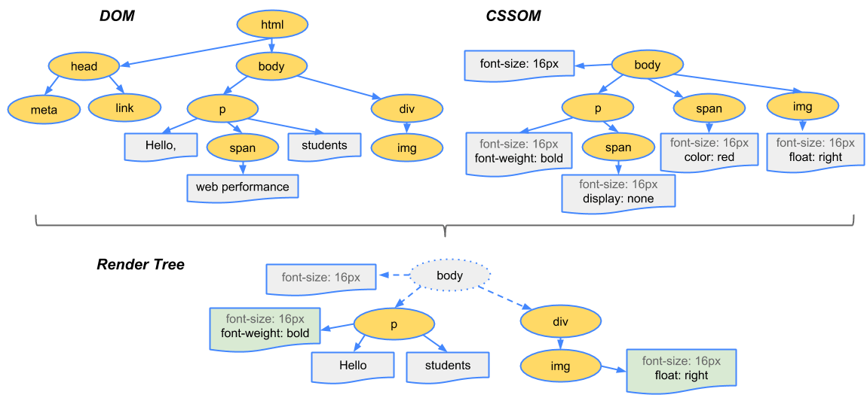
HTML CSS3
CSS = Cascading Style Sheets
CSS3 = Level of development (3)
CSS4 (flexbox)
https://developers.google.com/web/fundamentals/performance/critical-rendering-path/render-tree-construction

Slide 3
Cascading style sheet
Cascading…
Sizes…(https://www.w3schools.com/cssref/css_units.asp)
Display… (https://www.w3schools.com/cssref/pr_class_display.asp)

Slide 4
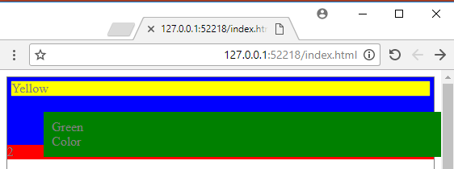
CSS - positions
\02 - CSS3\index.html

Slide 5
CSS - positions
Static – default
Fixed – fixed on window
Relative – relative to the position (div is still taking its place)
Absolute - the element is positioned relative to its first positioned parent, and don’t take space
Sticky – cool new feature (https://www.w3schools.com/cssref/tryit.asp?filename=trycss_position_sticky)

Slide 6
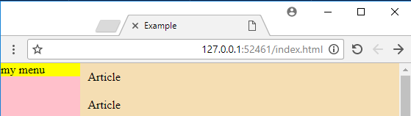
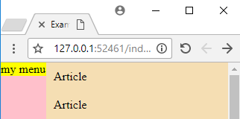
CSS – positions (workout)

Slide 7
CSS - Tables
<table>
<tr>
<th>
<tr>
<td>
<tr>
<tr>
<tr>
<tr>
https://www.w3schools.com/html/html_tables.asp

Slide 8
CSS – positions (float)
Float (right, left)

Slide 9
CSS - Flexbox
https://caniuse.com/#search=flex
https://css-tricks.com/snippets/css/a-guide-to-flexbox/
Container
Display: flex
item
item

